Slide 1
EHB420E — ARTIFICIAL NEURAL NETWORKS | TERM PROJECT
Accent and Language Identification from Speech
Input Representation or Learning Algorithm? A controlled Comparison of Gradient Boosting and 1D-CNNs
Yunus Gökdemir
040220060
Delfin Özdemir
040220087
Istanbul Technical University · Electronics and Communication Engineering

Slide 2
AGENDA
What We’ll Cover Today
Problem & Motivation
Why does accent/language ID matter?
Data & Process
Common Voice,the disk problem, pipeline
01
02
03
Two Representations
Summary statistics vs. time series
04
Three Models
XGBoost, Summary-CNN, Time-Series CNN
05
Results & Analysis
Accuracy, error analysis, training
06
Demo & Conclusion
Live interface and takeaways

Slide 3

Identifying Language from a Few Seconds of Speech
01 . PROBLEM
Determining a speaker's language - or even their accent - from just a few seconds of audio is a long-standing problem in speech processing. Reliable identification enables many applications:
OUR RESEARCH QUESTION
What determines success?
Accent-adaptive speech recognition
A) The learning algorithm we choose
Intelligent routing in call centers
B) Or the representation in which we feed the data to the model
Forensic speaker analysis
To separate these two factors, we designed a controlled, three-stage experiment.
Personalized feedback in language learning

Slide 4
Three Languages from Mozilla Common Voice
02 . DATA
1000
ARABIC
1000
ENGLISH
1000
FRENCH
audio clips
audio clips
audio clips
Dataset at a Glance
The Key to a Fair Comparison
3,000 labeled audio samples in total
All recordings resampled to 22.05 kHz
Typical clip duration ~5 seconds
80% train / 20% test (stratified sampling)
All three models were evaluated on the EXACT SAME test set. Because we split the data by index, the samples that land in the test set are identical across models. This way, any performance gap comes from the model, not from chance.

Slide 5
Hitting the Disk Limit: The Road to a Pipeline
02 . PROCESS - THE OBSTACLE WE FACED
1
2
3
First: Download Everything
Then: Separate by Language
Solution: Pipeline
>
>
We tried a mechanism that downloaded, processed, and deleted all data for the three languages.
We tried download-process-delete one language at a time.
We built a stream-based pipeline that processes data without ever writing it to disk.
Exceeded Google Colab's ~200 GB disk limit.
Still hit the disk limit; not sustainable.
Disk load dropped to nearly zero - problem solved.

Slide 6
Identifying Language from a Few Seconds of Speech
03 . DATA REPRESENTATION
In a single decoding pass, we extract two parallel representations from each recording. Their difference is critical:
S
Summary-Statistics Vector
T
Time-Series MFCC Matrix
54 dimensions
216 x 13
MFCC mean + std (26), ZCR (2), spectral rolloff (1), chroma (24), RMS (1)
216 time frames x 13 MFCC coefficients. Shorter clips are zero-padded, longer ones truncated to 216 frames.
DISCARDS all temporal order - keeps only an 'average' summary of the audio.
PRESERVES how the audio changes over time - exactly where accent is hidden.

Slide 7
How the Project Took Its Final Shape
THE STORY OF THE PROJECT
Beginning
It started as an XGBoost project my teammate began alone; the goal was to improve accuracy.
We Realized
XGBoost is not a neural network - on its own, it didn't fit an 'Artificial Neural Networks' course.
We Tried
We added a 1D-CNN. But with summary data, the CNN couldn't beat XGBoost (an interesting result).
We Understood
After research, we found 1D-CNNs work far better on time-series data.
Final Form
We turned the project into a controlled experiment comparing these THREE methods.

Slide 8
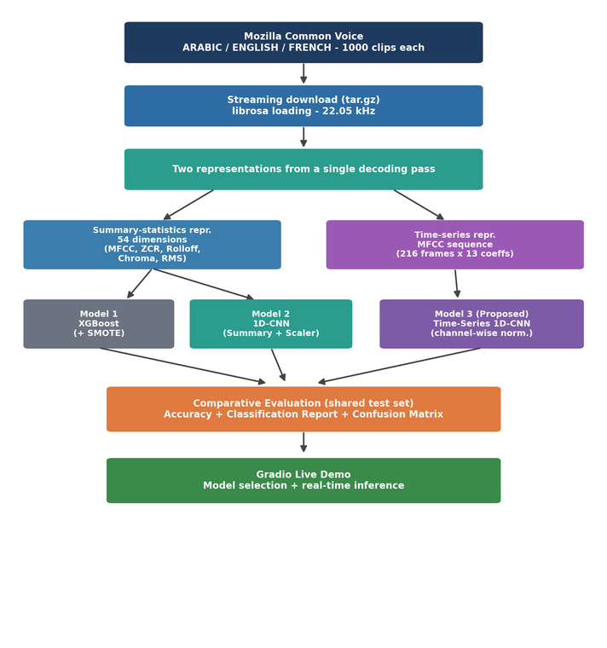
Overall System Flow
04 . APPROACH
Everything in One Pipeline
Data downloaded as a stream
CONTROLLED EXPERIMENT
Model 2 and Model 3 share the EXACT SAME architecture.
Two representations in one pass
Three models, same test set
The only thing that changes is the input representation. So any performance gap can only come from the data.
Comparative evaluation
= A fair, interpretable comparison
Live demo with Gradio

Slide 9
04 . MODELS
The Three Models We Compared
MODEL 1
MODEL 2
MODEL 3
XG-Boost
1D - CNN
Time Series 1D - CNN
A gradient-boosted tree ensemble trained on the 54-dim summary data. SMOTE was applied only to the training set to fix imbalance.
Uses the SAME summary data as XGBoost. Question: is a neural net better on the same input? Architecture kept identical to Model 3.
A gradient-boosted tree ensemble trained on the 54-dim summary data. SMOTE was applied only to the training set to fix imbalance.
BASELINE
CONTROL
BASELINE

Slide 10
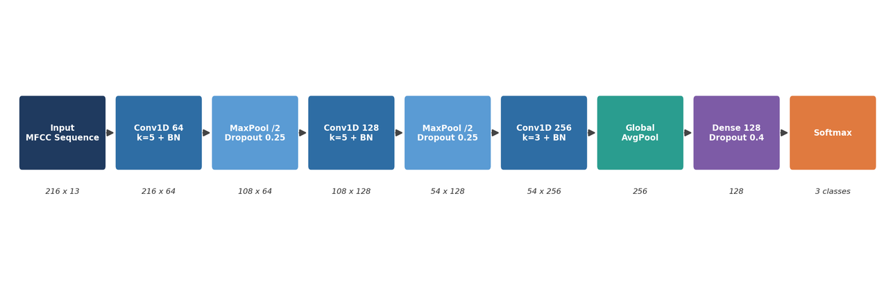

The Proposed Time-Series 1D-CNN
04 . ARCHITECTURE
TRAINING PROTOCOL
Optimizer
Adam (lr = 0.001)
Batch size
32
Loss
Sparse cat. cross-entropy
Validation
15% of training
Conv1D blocks (64->128->256), each with batch normalization; pooling for downsampling; global average pooling instead of flatten (fewer parameters); a 128-neuron dense layer + softmax.
Early stopping
patience of 15 epochs
LR scheduler
halves after 7 epochs
Max epochs
150

Slide 11
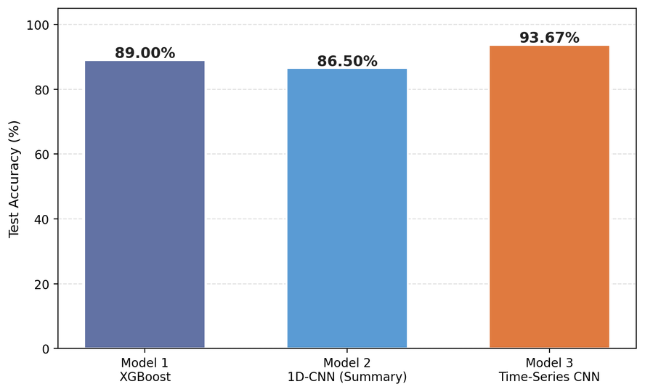
Overall Accuracy: Data Is the Decisive Factor
05 . RESULTS
% 89.00
Model 1 — XGBoost (baseline)
% 86.50
Model 2 — Summary CNN (didn't beat baseline)
% 93.67
Model 3 — Time-Series CNN
+4.67 points: the gain comes from TEMPORAL STRUCTURE, not the neural net.

Slide 12

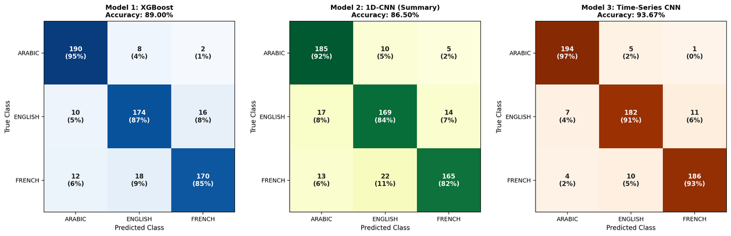
Where Do the Errors Concentrate?
05 . ERROR ANALYSIS
Takeaways
Eng-Fre confusion
The dominant error in all models; the phonetic closeness of the two languages makes it plausible.
Arabic is easiest
97% recall with the proposed model.
Errors down to 38
Total errors dropped from 66 and 81 to 38; the biggest gain is on the hard Eng-Fre pair.

Slide 13
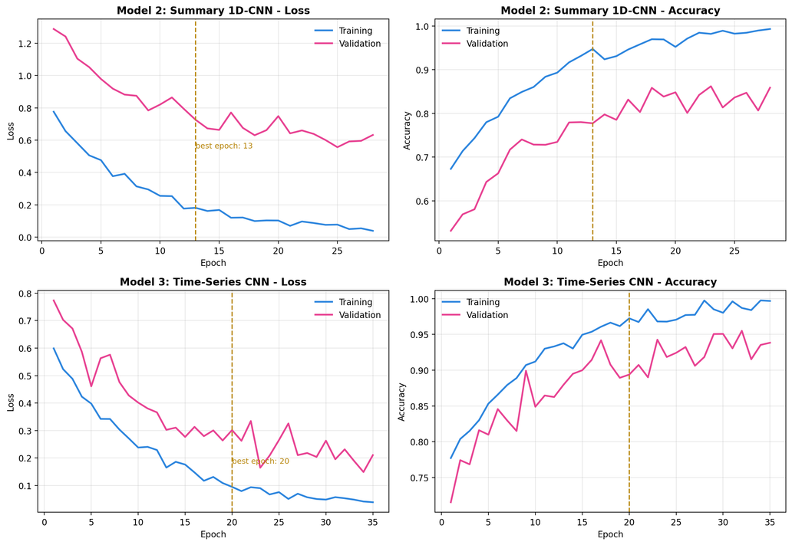

Learning Curves and Early Stopping
05 . TRAINING BEHAVIOR
What Do We See?
Validation curves closely track the training curves - no overfitting.
Early stopping fixes the weights at the best epoch (dashed line).
Dropout + batch norm provide enough regularization for our data size.

Slide 14

Real-Time Accent Identification
06 . LIVE DEMO
In our Gradio-based web interface, the user records or uploads a 5-second clip, then selects one of the three models. The clip is passed through the same preprocessing chain used in that model's training, and class probabilities are displayed instantly.
WHAT WE'LL SHOW
A live audio recording
All three models on the same audio
The difference the Time-Series CNN makes
Microphone or file — Both input methods supported
Model selection — XGBoost / Summary-CNN / Time-Series CNN
Probabilistic output — A confidence score for each language

Slide 15
What Did We Learn?
CONCLUSION
Main Finding
FutureWork
Data augmentation
For this task, the decisive factor is not the use of deep learning, but preserving the temporal structure in the input.
Noise addition, pitch shifting
New architectures
RNN / attention on top of convolutions
A CNN on summary data (86.50%) couldn't beat a well-tuned XGBoost (89.00%).
k-fold cross-validation
Tighter confidence estimates
The same network reached 93.67% on time-series data and nearly halved the errors.
Scaling up
Since the architecture was fixed, the gain came purely from the data representation.
More languages and within-language accents

Slide 16
Thank You
for listening!

